Slide 1
Estimating temporal Traffic Speed Based on LSTM for an urban network
Huynh Nam

Slide 2
Outline
Introduction
Goal
Methodology
Experiments
Conclusion

Slide 3
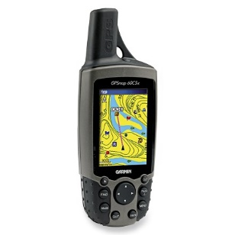


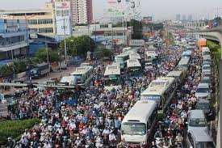
Introduction
Analysis traveler’s movement habit
Predicting traveler movement
Route planning in bus network
GPS
Real time finding path
……..
Wide ranged usage
Various kinds of location-based applications
Especially, in heterogeneous environment
Rush hour in Ho Chi Minh City, Vietnam
Notes:
GPS has wide ranged usage in various kinds of location-based applications
Especially in heterrogenegeneous environment in crowed city
On figure on the right, you can see the status of traffic jam in Ho Chi Minh city on rush hour
Therefore applying the GPS, we can develop many application as …… Those will contribute to solve problem in transportation

Slide 4
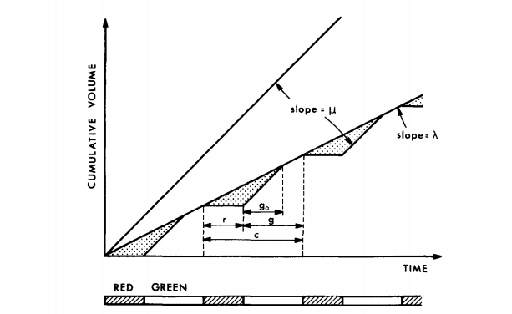
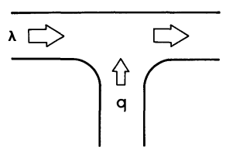
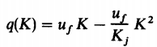
In the view of
Mathematician
Machine Learning
Sheriff’s equation
Notes:
Density and speed has linear relationship

Slide 5
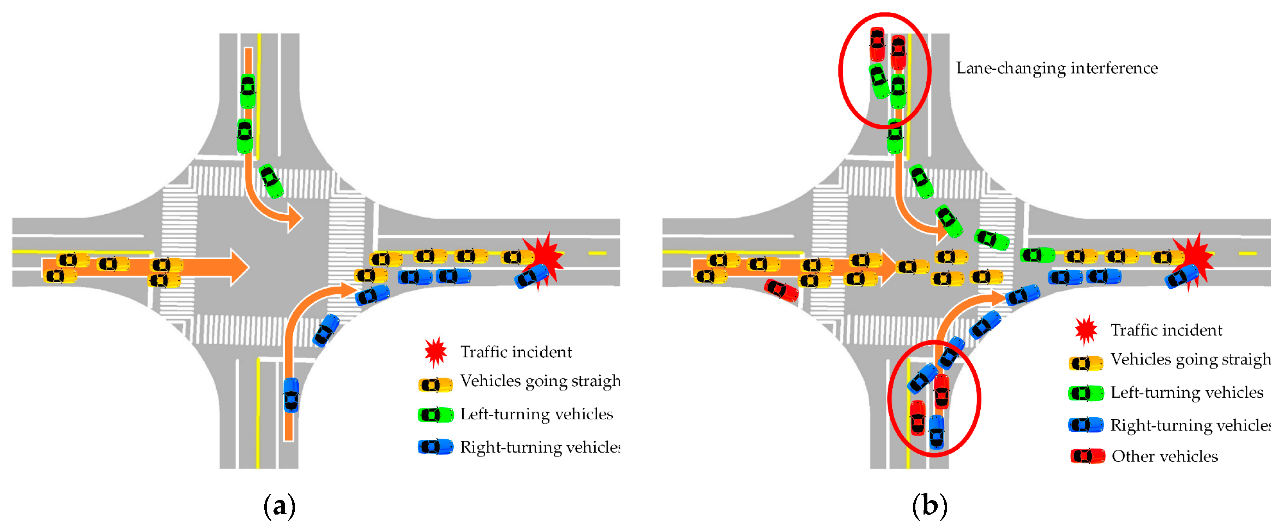
In the view of Mathematic
Notes:
Shockwave

Slide 6
Related Works (2015 – 2017)
- Three challenges in task of traffic forecasting: (1) Complex spatial dependency among adjacent roads, (2) non-linear temporal dynamics dependency and (3) state of traffic dependency of long-term forecasting [14].
- LSTM layer with memory block and one output layer to predict traffic speed with travel speed data collected by traffic microwave detectors in Beijing. [8]
- The Hybrid Model which combines to DCNNs to produce SRCNs. This hybrid model promises to capture spatial dependency from DCNNs and temporal relation from LSTM in static image which expresses the state of traffic by speed in network transportation with 278 links in Beijing [4].
- Both the correlation of spatial speed data in different location and the dependencies of temporal speed data can be recognized during learning process. Deep stacked bidirectional and unidirectional LSTM network which is proposed as novel deep architecture has BDLSTM layer and LSTM layer [7].
- The sharp non-linearity in transitions between states of traffic flow: free flow, breakdown, recovery and congestion by spatial and temporal effects [15].
Notes:
In recent years, deep learning plays important role in Intelligent Transportation System (ITS) problems that is specifically relevant for predicting traffic flow or traffic speed. Long short term memory (LSTM) which is a branch of Recurrent Neural Network is highlighted in this site. The reasons that LSTM has concerned are three challenges in task of traffic forecasting: (1) Complex spatial dependency among adjacent roads, (2) non-linear temporal dynamics dependency and (3) state of traffic dependency of long-term forecasting [14]. LSTM model is capacity in capturing non-linear traffic dynamic and determining the optimal time lags automatically. The research proposes the LSTM structure with one input layer, LSTM layer with memory block and one output layer to predict traffic speed with travel speed data collected by traffic microwave detectors in Beijing. Then MAPE and MSE is used to validate their model and the result shows that LSTM model has higher accuracy and more stability than some types of neural network [8]. Besides LSTM is also used in hybrid model which combines to DCNNs to produce SRCNs. This hybrid model promises to capture spatial dependency from DCNNs and temporal relation from LSTM in static image which expresses the state of traffic by speed in network transportation with 278 links in Beijing [4]. Spatial and temporal association are challenges in traffic prediction – a novel method DCRNN is proposed to combine the relations of spatial and temporal features. Bi-directional random walks on the graph to capture the spatial features and encoder-decoder architecture extracts the temporal relation. This traffic flow model is considered as diffusion process in the directed graph [14]. When the spatial – temporal information has been fed into the traffic network as the Bidirectional Long Short Term Memory (BDLSTMs), both the correlation of spatial speed data in different location and the dependencies of temporal speed data can be recognized during learning process. In there, each deep stacked bidirectional and unidirectional LSTM network which is proposed as novel deep architecture has BDLSTM layer and LSTM layer [7]. Another research is also shows that deep learning architectures has ability to solve the sharp non-linearity in transitions between states of traffic flow: free flow, breakdown, recovery and congestion by spatial and temporal effects [15].

Slide 7
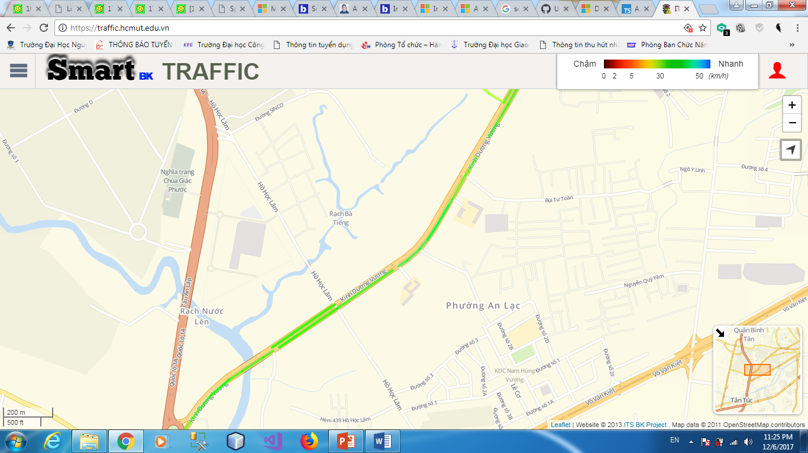
Goal
Notes:
Predicting Space Mean Speed
22h

Slide 8
Methodology
Data Collection
Data pre-processing
LSTM Network
Prediction Model

Slide 9





Data Collection
SEVENADS

Slide 10
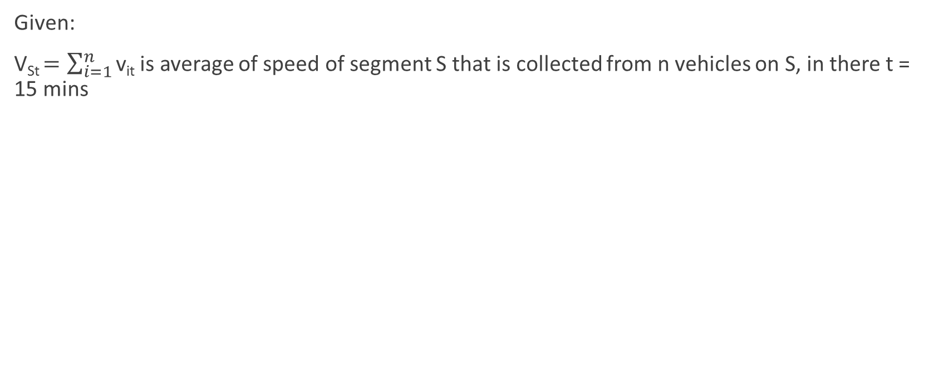
How to collect speed data for segment
Given:
V_{St} $=\sum_{i=1}^{n}{\text{v}\text{it}}$ is average of speed of segment S that is collected from n vehicles on S, in there t = 15 mins
Segment S
T = 15 mins

Slide 11
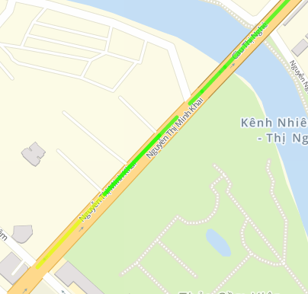
Data Pre-processing
AVERAGE TRAVEL SPEED
TIME STEPs = 15 MINS
REMOVING:
REDUNDANT
ERROR
NOISE
…..

Slide 12
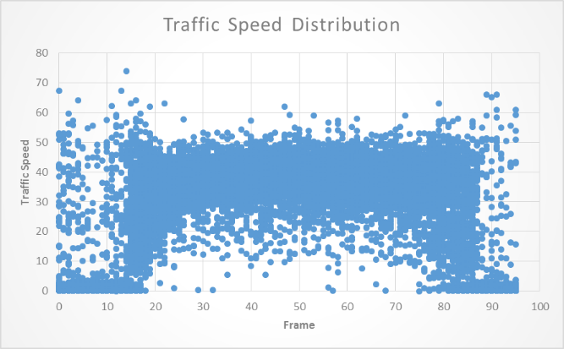
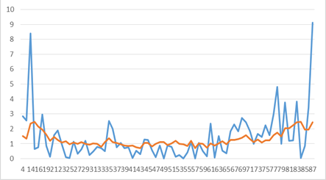
Speed – Frame – Workday Features
Notes:
5h-9h
10h-14h30
15h45 – 19h15

Slide 13
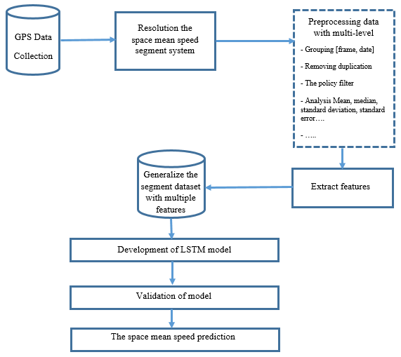
Methodology

Slide 14
Prediction Model
Sequential type
Data type: speed₀, speed­₁,…, speed­_{k-1} → speed­_{k}
Frame type
Given fs_{k} = (frame_{k} , speed_{k}) Data type: fs₀, fs₁,…, fs_{k-1} → speed­_{k}
Workday type
Given dfs_{k} = (day_in_week_{k}, frame_{k} , speed_{k}) Data type: dfs₀, dfs₁,…, dfs_{k-1} → speed­_{k}

Slide 15
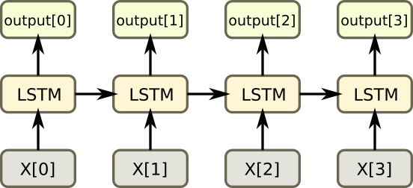
LSTM Network

Slide 16
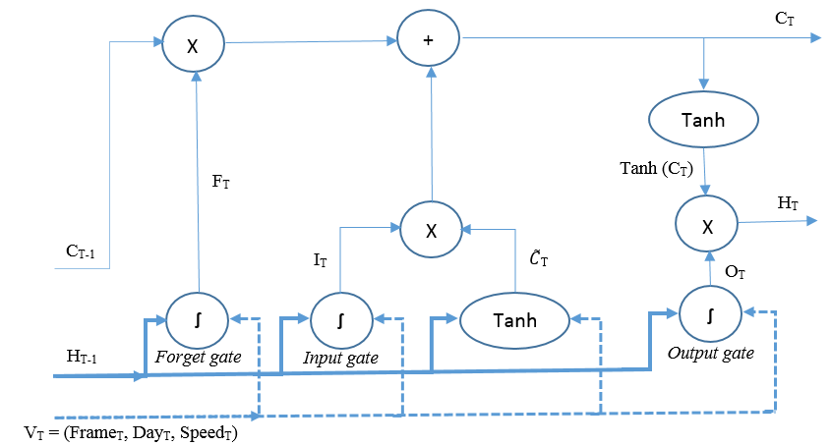
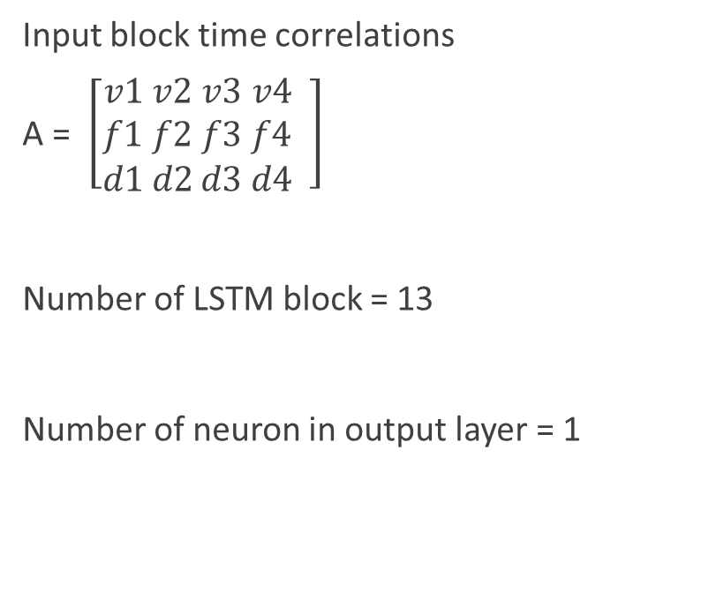
Prediction Model
Input block time correlations
A = $\left[\begin{matrix}v1 \\ f1 \\ d1\end{matrix}\begin{matrix} v2 \\ f2 \\ d2\end{matrix}\begin{matrix}v3 \\ f3 \\ d3\end{matrix} \begin{matrix}v4 \\ f4 \\ d4\end{matrix} \right]$
Number of LSTM block = 13
Number of neuron in output layer = 1

Slide 17
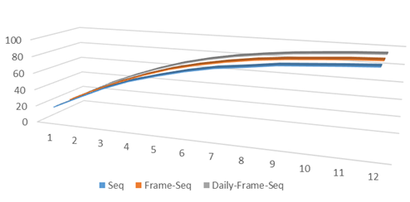
Experiment
- 8669 space mean speed data points o segment 68859
- 80% training and 20% testing
LSTM
 | Training |  |  | Validation
 | Seq | Frame | Day | Seq | Frame | Day
RMSE | 6.5 | 6.5 | 6.5 | 5.8 | 5.8 | 5.8
MAPE | 13.7 | 13.7 | 13.6 | 15.4 | 15.4 | 15.2
ANN
 | Training |  |  | Validation
 | Seg | Frame | Day | Seg | Frame | Day
RMSE | 5.8 | 5.8 | 5.8 | 6.5 | 6.5 | 6.5
MAPE | 13.8 | 13.8 | 13.9 | 15.9 | 15.9 | 16.1

Slide 18
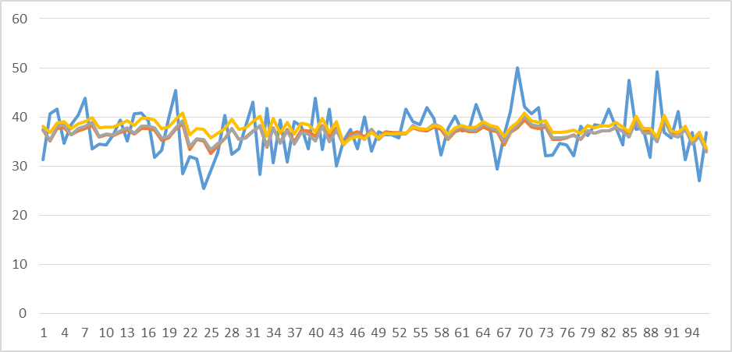
The evaluation
The shift problem

Slide 19
Conclusion
- In this paper a multiple type dataset was developed through statistically for feeding LSTM model to improving the prediction result in advance, a model-based technique is proposed to predict the expected the next space mean speed which happens according to some feature and previous steps. The study also compares among results and conducts the features which affect the prediction model directly. The results obtained from the overall study are promising to be able to implement an APTS to forecast the space mean speed in urban traffic system which is important criterion in modern city.
- However, there are also many things to discuss to improve the prediction accuracy in the experiment. Some problem will be remind as: the relation of adjacent roads which are surrounding the segment affect the model and so on.

Slide 20
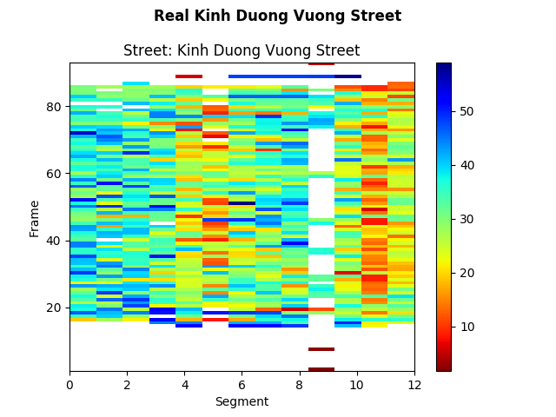
Future Works
Notes:
đồ thị cho ta thấy có mối liên hệ về vận tốc giữa không gian các segment gần nhau theo thời gian.

Slide 21
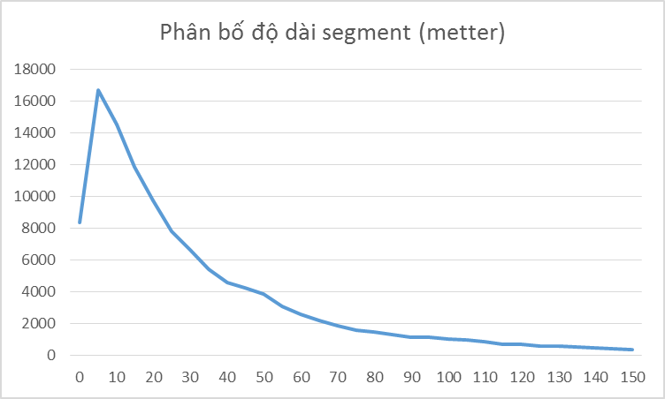
Problems
Notes:
Have 95% segments have length in interval 0 to 150 meters

Slide 22
Some problems
How long is the frame T
The impacts of length of segment
Why does the prediction line shift on actual line
How do we analysis the data, after that find out the model which is adaptive the data
How do the adjacent segments affect the result of speed prediction on segment
How can we extract the spatial feature of adjacent segments
How do we prediction for entire the urban segment network

Slide 23
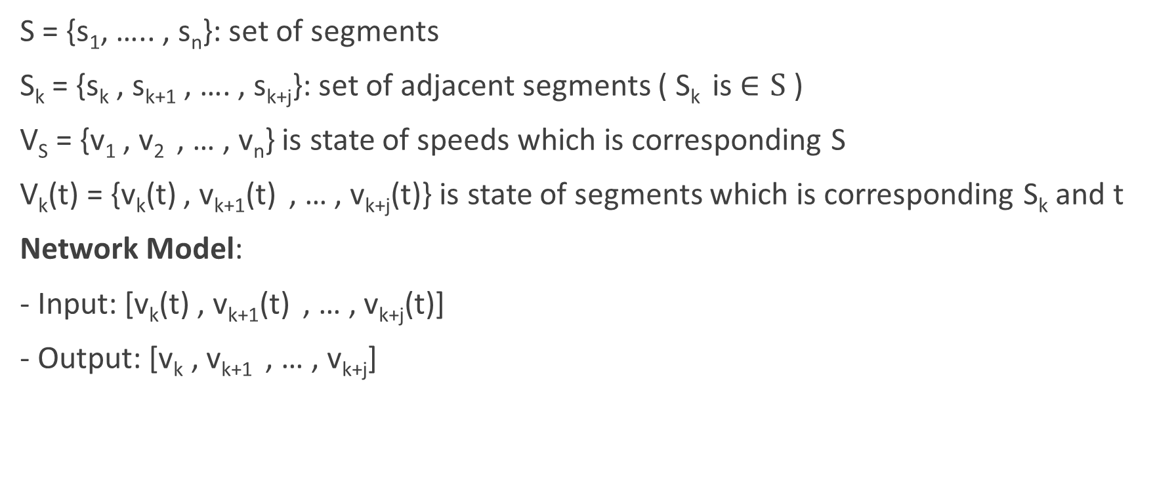
Model Development
S = {s₁, ….. , s_{n}}: set of segments
S_{k} = {s_{k} , s_{k+1} , …. , s_{k+j}}: set of adjacent segments ( S_{k} is $∈S$ )
V_{S} = {v₁ , v₂ , … , v_{n}} is state of speeds which is corresponding S
V_{k}(t) = {v_{k}(t) , v_{k+1}(t) , … , v_{k+j}(t)} is state of segments which is corresponding S_{k} and t
Network Model:
- Input: [v_{k}(t) , v_{k+1}(t) , … , v_{k+j}(t)]
- Output: [v_{k} , v_{k+1} , … , v_{k+j}]
Notes:
Với mỗi mốc thời gian ta có một vector trạng thái cho toàn các segment

Slide 24
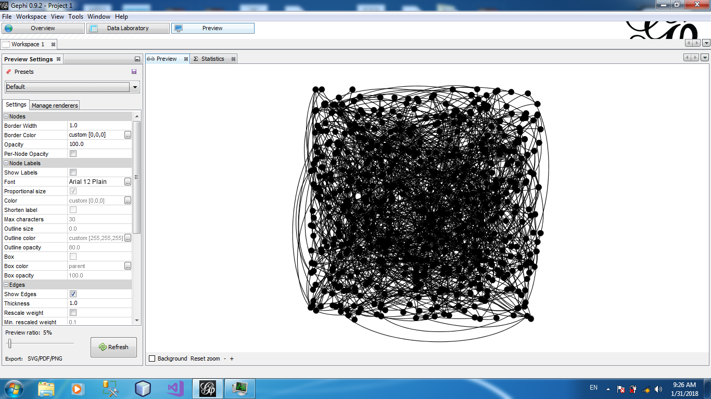
Urban Segment Network
Notes:
Vấn đề phát sinh là làm sao bỏ dữ liệu NULL khi tham gia vào quá trình huấn lyện

Slide 25
Problems
1. Learning periodical feature by LSTM
2. Determine the correlation among adjacent segments, the correlation among areas
3. LSTM prediction model for HCMC City
4. How to combine local features and global features in prediction model
5. Handling missing data in prediction model

Slide 26
REFERENCES
[1] Mohammadhani Fouladgar, Mostafa Parchami, Ramez Elmasri and Amir Ghaderi, “Scalable Deep Traffic Flow Neural Networks for Urban Traffic Congestion Prediction,” arXiv:1703.01006, Mar 3, 2017.
[2] Yuhan Jia, Jianping Wu and Ming Xu, “Traffic Flow Prediction with Rainfall Impact Using a Deep Learning Method,” Journal of Advanced Transportation, vol. 2017 (2017), 2017.
[3] KrantiKumar, M.Parida and V.K.Katiyar, “Short Term Traffic Flow Prediction for a Non Urban Highway Using Artificial Neural Network,” Procedia - Social and Behavioral Sciences, vol. 104, pp. 755-764, December 2, 2013.
[4] Haiyang Yu, Zhihai Wu, Shuqin Wang, Yunpeng Wang and Xiaolei Ma, “Spatiotemporal Recurrent Convolutional Networks for Traffic Prediction in Transportation Networks,” Sensors, vol. 17, May 4, 2017.

Slide 27
REFERENCES
[5] Xiaolei Ma, Zhimin Tao, Yinhai Wang Haiyang Yu and Yunpeng Wang, “Large-Scale Transportation Network Congestion Evolution Prediction Using Deep Learning Theory,” PLOS, vol. 10, Mar 17, 2015.
[6] Alfréd Csikós, Zsolt János Viharos and Krisztián Balázs Kis, “Traffic speed prediction method for urban networks — an ANN approach,” 2015 International Conference on Models and Technologies for Intelligent Transportation Systems, August 27, 2015.
[7] Zhiyong Cui, Ruimin Ke and Yinhai Wang, “Deep Stacked Bidirectional and Unidirectional LSTM Recurrent Neural Network for Network-wide Traffic Speed Prediction,” The 6th International Workshop on Urban Computing, August 14, 2017.
[8] Xiaolei Ma, Zhimin Tao, Yinhai Wang Haiyang Yu and Yunpeng Wang, “Long short-term memory neural network for traffic speed prediction using remote microwave sensor data,” Transportation Research Part C, vol. 54, pp. 187-197, May ,2015
[9] Qing Ye, W. Y. Szeto and S. C. Wong, “Short-term traffic speed forecasting based on data recorded at irregular intervals,” IEEE transactions on intelligent transportation systems, vol. 13, December, 2012.

Slide 28
REFERENCES
[10] Rafal Jozefowicz, Wojciech Zaremba and Ilya Sutskever, “An empirical exploration of recurrent network architectures,” Journal of Machine Learning Research, 2015
[11] Christopher Olah, “Understanding LSTM Networks,” August 27, 2015
[12] Razvan Pascanu, Tomas Mikolov and Yoshua Bengio, “On the difficulty of training recurrent neural networks,” e-print arXiv:1211.5063, November 2012.
[13] Sepp Hochreiter and Jürgen Schmidhuber, “Long short-term memory,” Neural Computation, vol. 9, pp. 1735-1780, November 15, 1997.
[14] Yaguang Li, Rose Yu, Cyrus Shahabi and Yan Liu, “Diffusion Convolutional Recurrent Neural Network: Data-driven Traffic Forecasting”, ArXiv, November 8, 2017.
[15] Nicholas G. Polson, Vadim O. Sokolov, “Deep learning for short-term traffic flow prediction”, 17 March 2017.

Slide 29


